Slide 1

Keolis Grand Nancy
Group Keolis

Slide 2
Program
Keolis Grand Nancy presentation
My work presentation

Slide 3

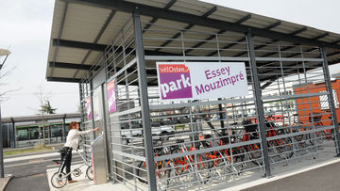
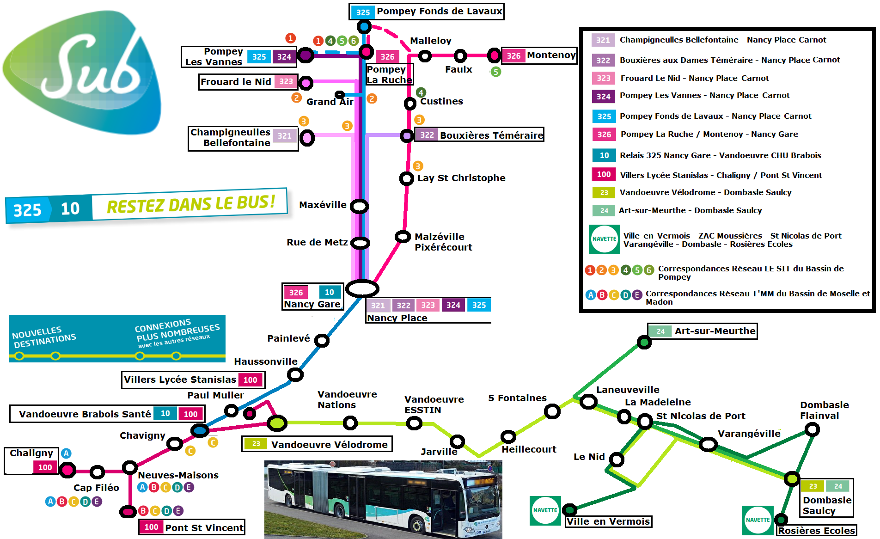
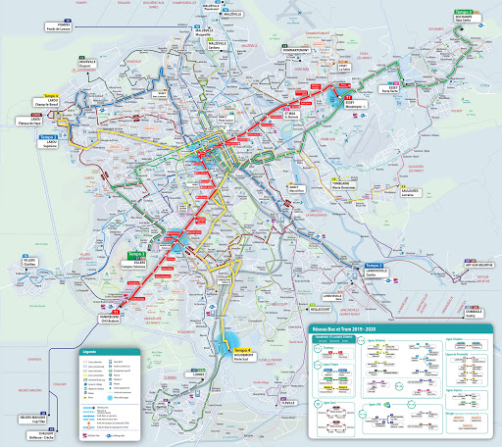
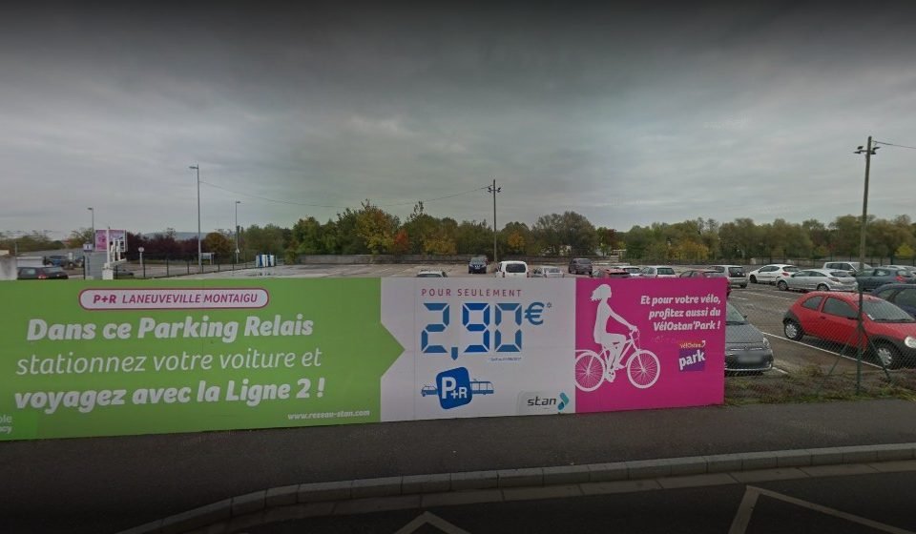
Transport network of the « Grand Nancy » city
Bicycle park
Car park relay
Urban buses
Suburban buses

Slide 4
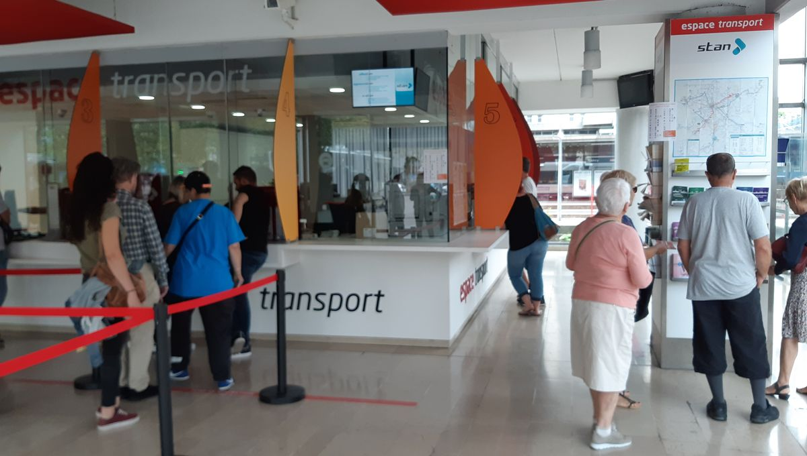
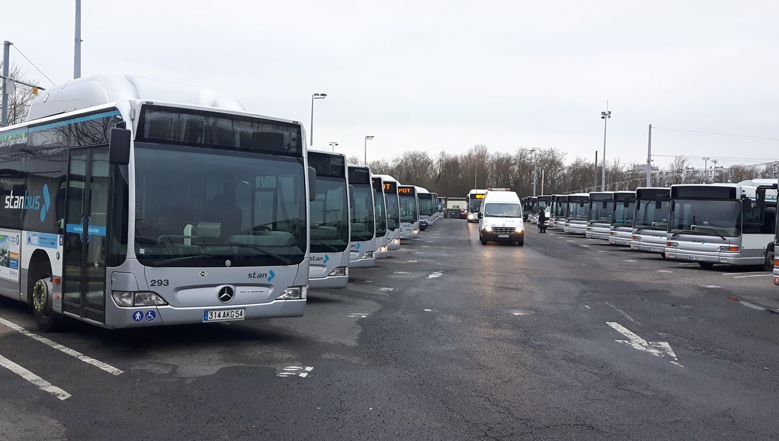
Three places
Control post
Business agency : for customers
Depot : 800 workers

Slide 5
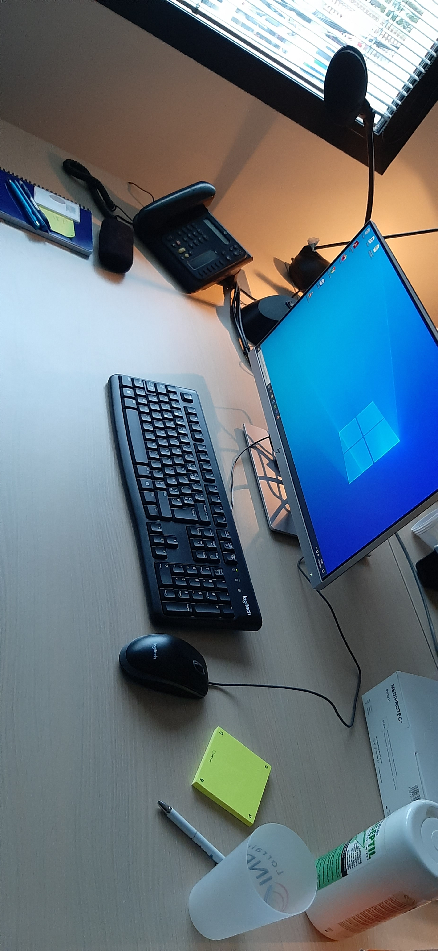
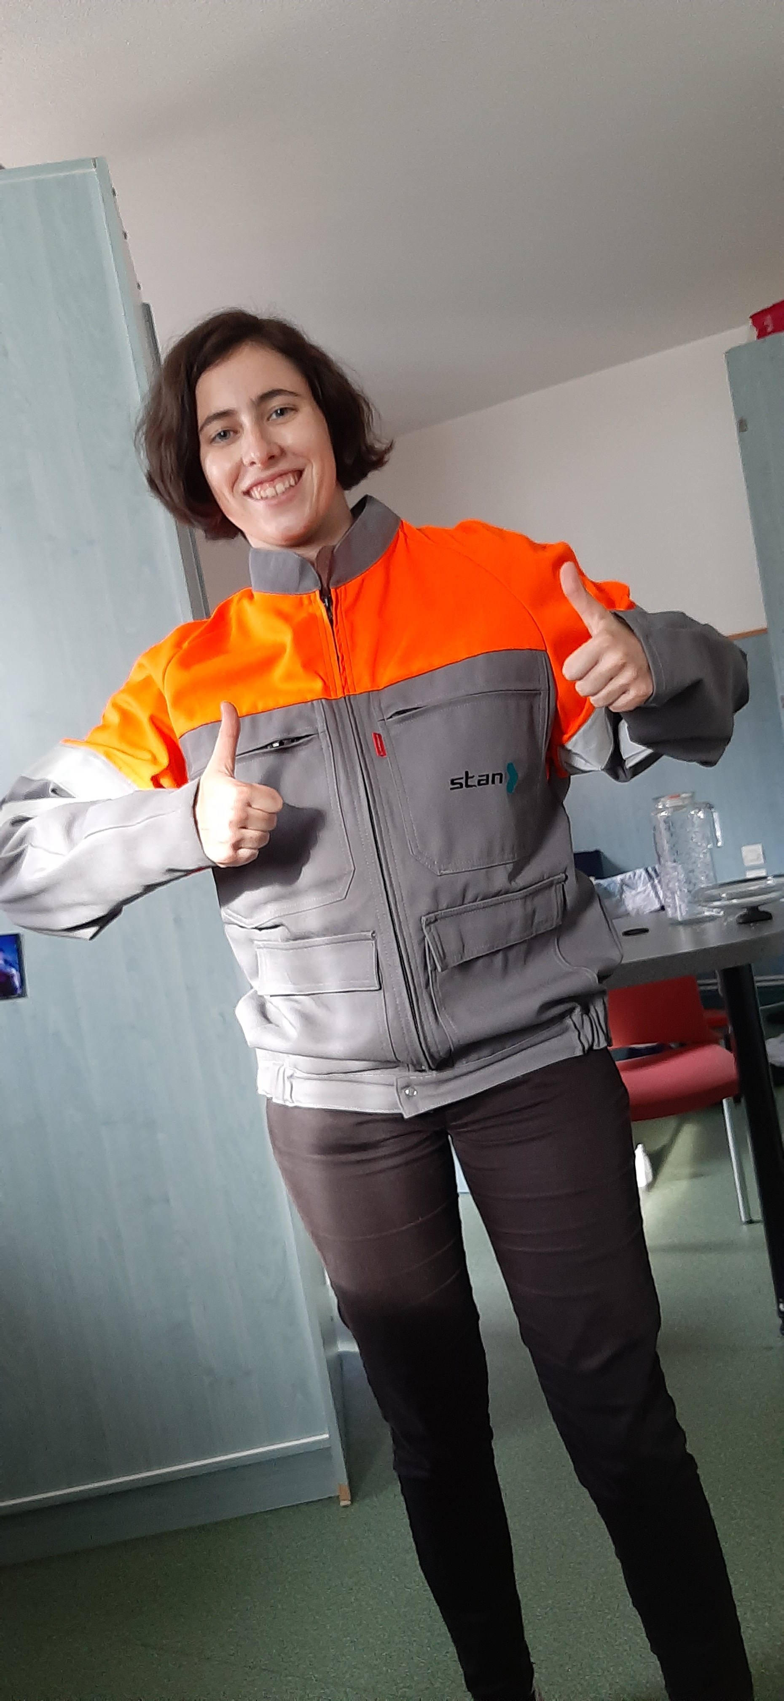
My work
Period 1
Other periods

Slide 6
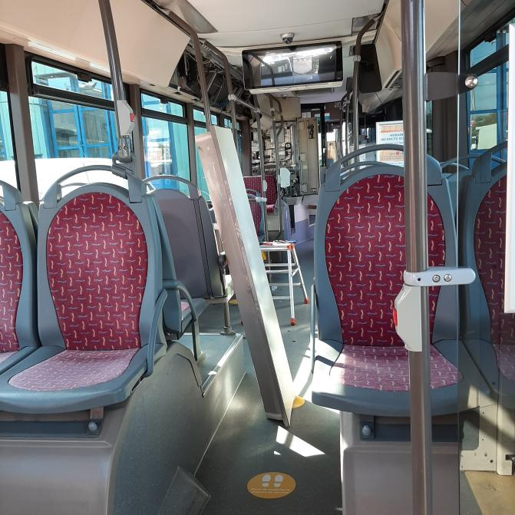
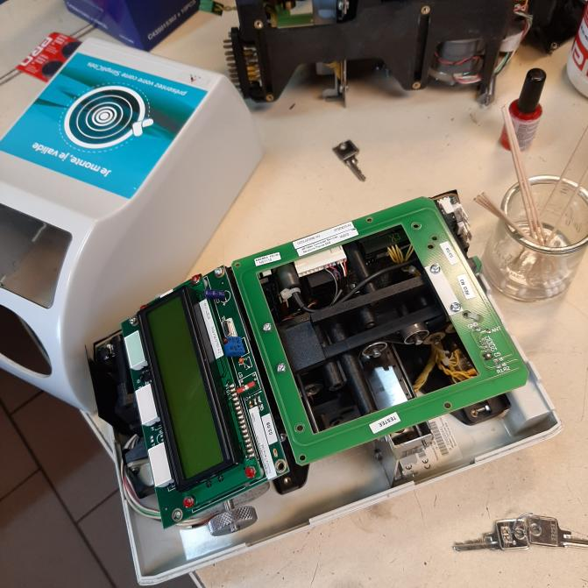
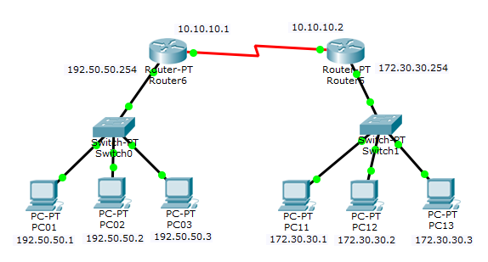
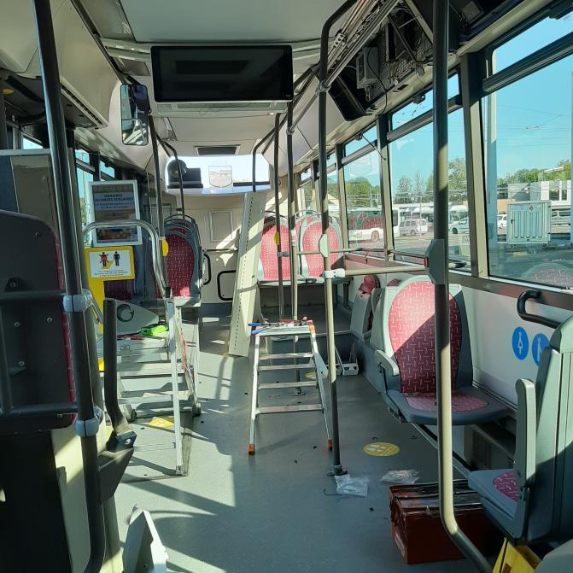

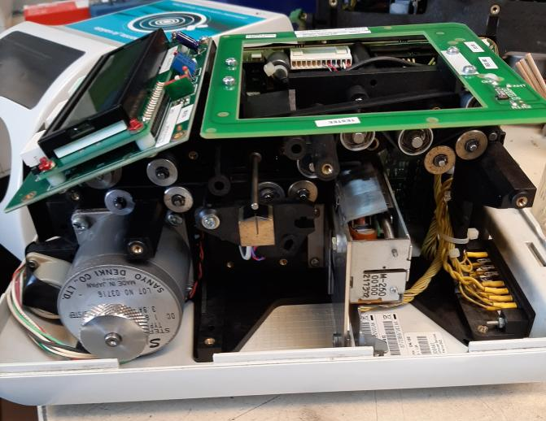
Low current/ high current department (SCFCF)
Embedded systems reparation in buses
Bus quay equipment reparation
City and depot network reparation
Development of intern application for the department

Slide 7
IT department (DSI)
Project managment betwen DSI and SCFCF
Exempl : introduction of a new mode of real-time counting of bus users.

Slide 8
Conclusion
1st period : interesting
Others periods : look foward

